Slide 1
Mitigation of Climate Change as a Child's Right
OMEP Aotearoa New Zealand/OMEP Pacific Island Nations
with
Asia-Pacific Regional Network for Early Childhood
Bernard van Leer Foundation
Presented by Glynne Mackey

Slide 2
“Put simply, the current commitments are still not enough to say with any confidence that the Pacific will survive.”
Fijian Climate Activist Sivendra Michael. (27 Oct 2021)
The early childhood and climate change communities need to respond together, for the sake of children living now and in generations to come (Pegram and Colón, 2019. cited in Clark).

Slide 3
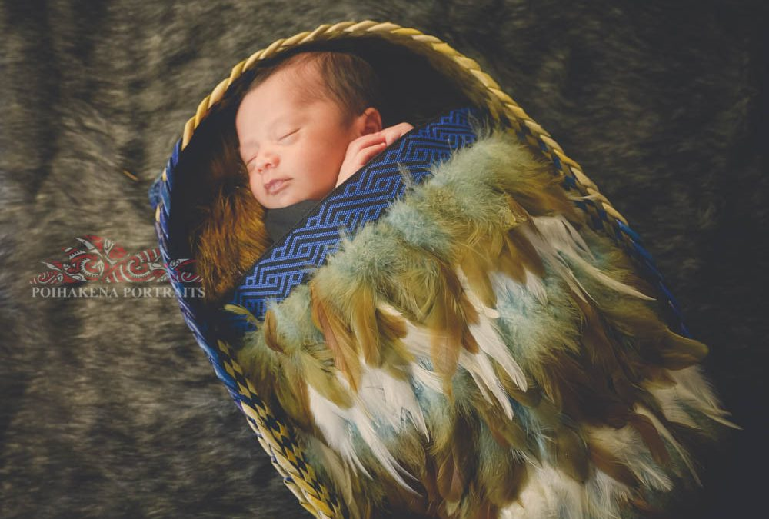
Bernard van Leer Foundation & ARNEC
BvLF is partnering with ARNEC to disseminate the Early Childhood Matters (ECM) 2021 edition, to encourage the early childhood community to discuss the most serious issues impacting on young children.
Early Childhood Matters 2021 is a journal publication dedicated to examining the many ways that climate change and early childhood intersect.
OMEP Aotearoa New Zealand with OMEP Pacific Island Nations are leading a project to discuss how we can lessen the impact of climate change on our young children.

Slide 4
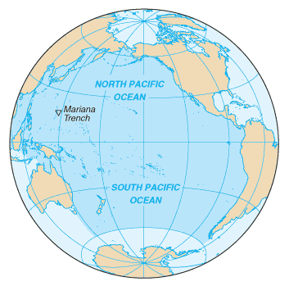
The focus of the Project
To focus on communities in both Aotearoa New Zealand [NZ] and in the Pacific Island Nations. There are diverse communities in Aotearoa NZ; these include Pacific Island and Māori communities, amongst others - diverse in geographical location, cultural context and available resources.
To consider the intersectionality where the third world conditions of many Pacific Island Nations intersect with the rising sea levels due to climate change.
To honour the commitment of the governments of Aotearoa NZ and the Pacific Island Nations to climate change. Aotearoa NZ has a long-standing responsibility to our Pacific neighbours, through aid programmes, education, and now, e.g., relocating climate change refugees from the Pacific Islands such as Tuvalu (100 balloted places per annum).

Slide 5
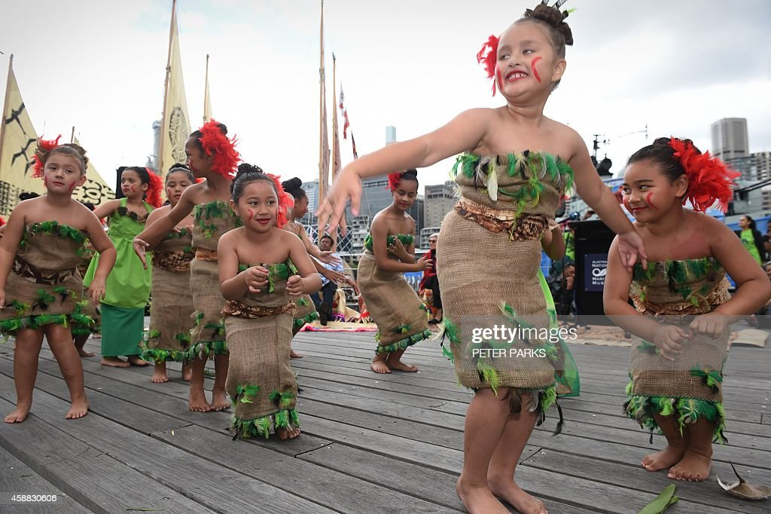
What does the project involve?
Through our early childhood networks and communities, we invite individuals and groups to participate
Participants can read short articles before the meeting or the articles may be read aloud at group meetings.
Two or three readings to be selected from Early Childhood Matters 2021.
Participants read and discuss, using a template as a guide to focus discussion.
Funding is available to support the management of the project,
& disseminate the materials.

Slide 6
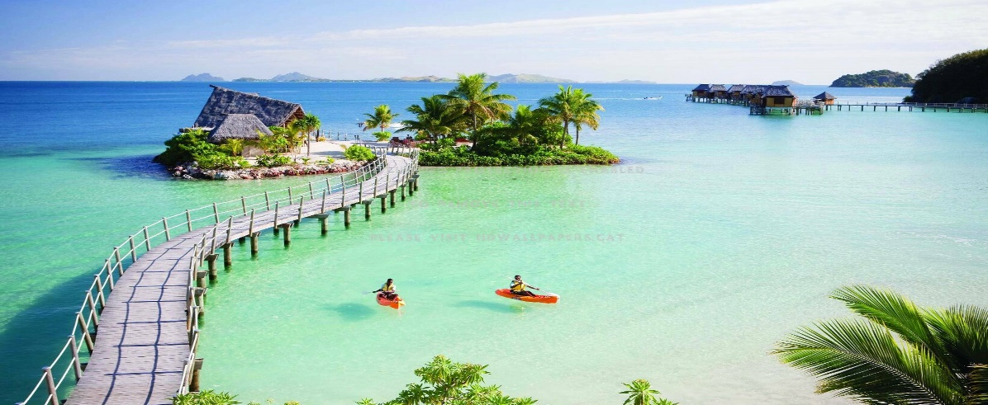
Guiding the reading
Examples of discussion starter questions:
How has the reading impacted on my thinking?
How are children in our local community and culture impacted by climate change?
In my/our work with young children, what will I/we do differently, now that I/we have this new knowledge and understanding?
As early childhood leaders or teachers who are part of a community, how can I/we:
Promote ecological resilience
Improve wellbeing

Slide 7
The Readings
Articles selected:
Helen Clark. Governments of the world must prioritise children, amid climate change.
Kelly Ann Naylor. Climate change – induced water insecurity endangers children.
Richard Louv. There are huge risks in raising children under what amounts to house arrest.
Jantirar Abay. In Addis Ababa learning through outdoor play.

Slide 8
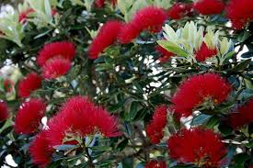
Collating Responses
Groups and individuals send their discussion notes back to OMEP Aotearoa National Exec: omepaotearoa@gmail.com
We will gather the completed templates and work collaboratively to collate the responses and complete an evaluation report for ARNEC & BvL

Slide 10
Our climate change future
Key findings will be sent to participants so that the discussions and findings will give communities the motivation & inspiration to:
advocate for their young childrens’ resilience and wellbeing
take their concerns to local community leaders and politicians
take action & develop community projects
look to the future with hope
Transformative action will help to mitigate the impact of climate change on our young children.

